Slide 1
FASHION RENTAL HUB
Submitted in the partial fulfillment for the award of the degree of
BACHELOR OF ENGINEERING
IN
CSE-AIML
Submitted by:
NAME OF THE STUDENT
Aditya Bharti-21BCS6514
Vaibhav Verma-21BCS6557
Aastha Khandelwal-21BCS6412
Under the Supervision of:
SUPERVISOR NAME
Jaswinder Singh
Department of AIT-CSE
DISCOVER . LEARN . EMPOWER

Slide 2
Outline
Introduction to Project
Problem Formulation
Objectives of the work
Methodology used
Results and Outputs
Conclusion
Future Scope
References

Slide 3
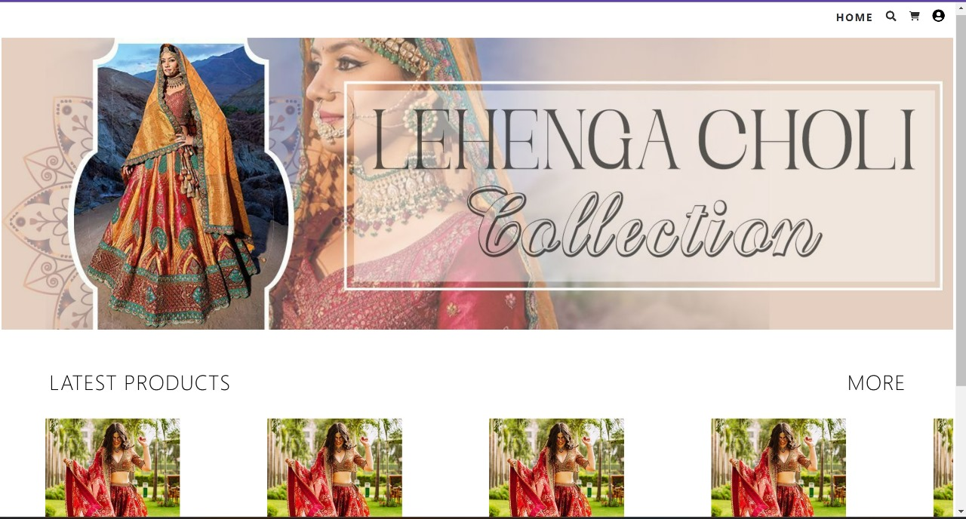
Introduction to Project
Fashion Rental Hub offers a sustainable and affordable clothing rental platform built with MERN stack, aiming to revolutionize fashion access through a user-friendly experience.

Slide 4
Feature/characteristics Identification
Rental System: Define flexible rental periods, shipping options, damage/loss protection, and optional cleaning services.
User Experience: Design an intuitive search with filters, wishlist, rental history, review system.
Payment System: Integrate secure gateways, explore subscription plans and pay-per-wear models.
Constraint Identification
Business: Sourcing quality inventory, logistics management, pricing strategy, marketing in a competitive space.

Slide 5
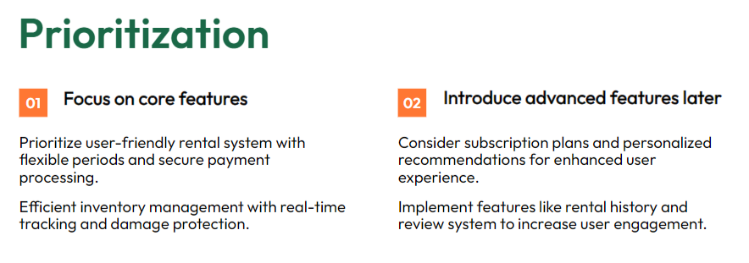
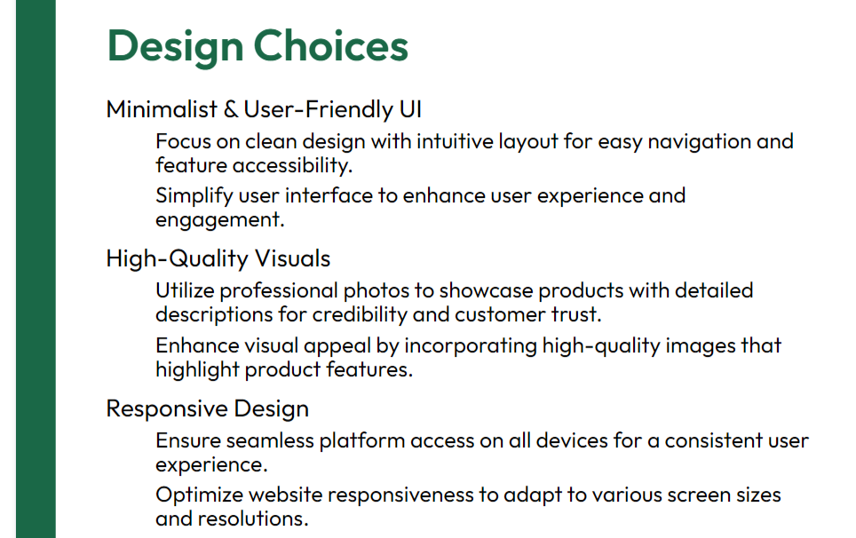

Slide 6
Objectives of the Work
Promoting Sustainability
Increasing customer Engagement
Supporting Charitable Organization
Improving Customer Experience

Slide 7
Methodology used
Requirement gathering
Planning
Design
Development
Testing
Deployment
Maintenance

Slide 8
Current Features:-
Clothing item browsing and filtering
Item details and image gallery
Shopping cart management
Rental booking and cancellation
User account management
Email notifications for rental updates
Planned Updates:-
Advanced search and filtering: Enhance the search functionality to allow users to filter items by multiple criteria (e.g., color, material, occasion).
Mobile application: Develop a mobile application to provide a seamless experience for users on the go.
Subscription plans: Offer subscription plans that provide discounts and exclusive access to new items.

Slide 9
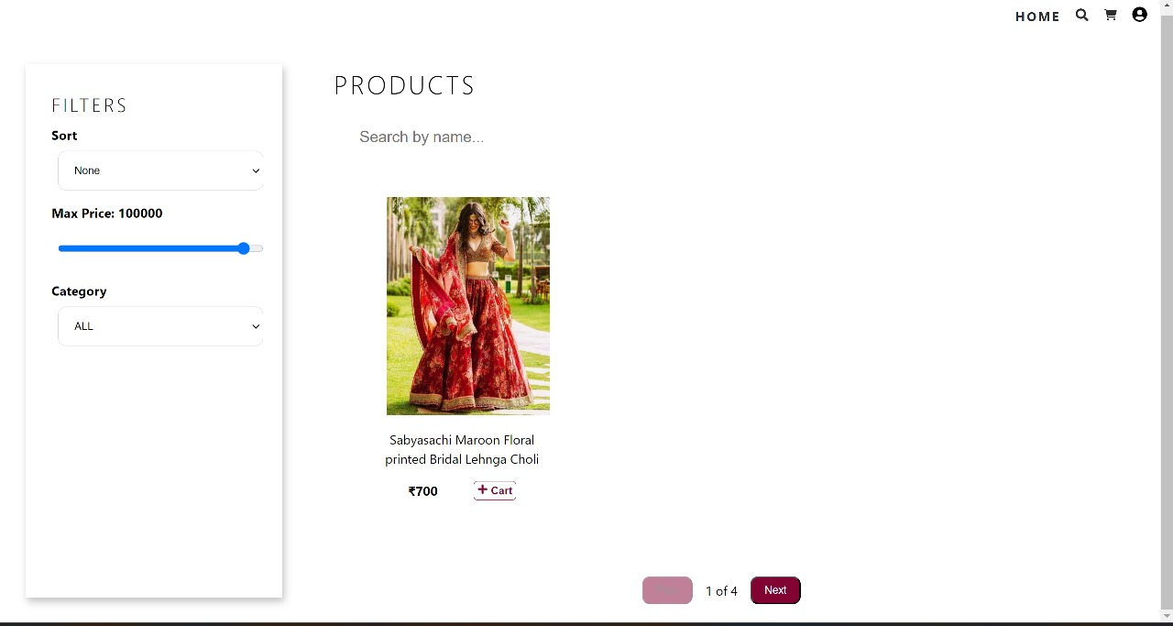
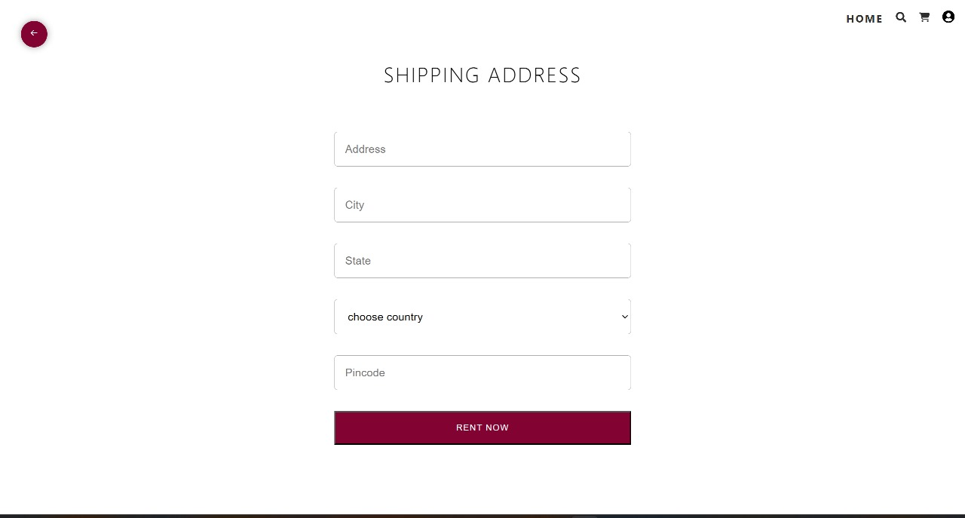
Results and Outputs

Slide 10
Conclusion
The development of the Fashion Rental Hub represents a significant advancement in the domain of online fashion rental platforms. By adhering to a systematic methodology encompassing design, development, testing, and deployment phases, a robust and user-friendly application was realized.
The methodology facilitated a clear understanding of user requirements, leading to the implementation of comprehensive functionalities catering to both users and administrators. The use of modern technologies such as Node.js, Express.js, React.js, and MongoDB ensured efficient data management and seamless user interaction.
Specialty Collections: Introducing specialty collections tailored to specific demographics or occasions, such as maternity wear, formal events, or athleisure. These curated collections would cater to the unique needs and preferences of different customer segments, enhancing the platform’s appeal and versatility.
Expanded Size Range: Ensuring inclusivity in sizing by expanding the range of available sizes to accommodate a diverse range of body types and shapes. This could involve working closely with suppliers and designers to offer extended size options and promote body positivity.

Slide 11
Future Scope
International Expansion: Exploring opportunities for international expansion to reach a broader audience beyond the current geographical scope. This could involve establishing partnerships with international suppliers, adapting the platform to accommodate multiple languages and currencies, and navigating logistical challenges associated with cross- border operations.
Personalization and Recommendation Features: Implementing personalized recommendation features based on user preferences, browsing history, and past rental behavior. Leveraging data analytics and machine learning algorithms, the platform could offer tailored suggestions to enhance the shopping experience and encourage repeat usage.
Sustainability Initiatives: Prioritizing sustainability by partnering with eco-conscious brands, offering eco-friendly clothing options, and implementing environmentally friendly practices throughout the supply chain. This commitment to sustainability would resonate with environmentally conscious consumers and align with growing demand for ethical fashion alternatives.
Through rigorous testing, potential issues were identified and resolved, guaranteeing the reliability and functionality of the application. Deployment to a cloud platform further enhanced accessibility and scalability, accommodating potential future growth.

Slide 12
References
[1] Grose, Lynda & Fletcher, Kate. (2012). Fashion and sustainability: Design for Change.
[2] Niinimäki, Kirsi & Peters, Greg & Dahlbo, Helena & Perry, Patsy & Rissanen, Timo & Gwilt, Alison. (2020). The environmental price of fast fashion. Nature Reviews Earth & Environment. 1. 189-200. 10.1038/s43017-020-0039-9.
[3] Ellen MacArthur Foundation. (2017). A new textiles economy: Redesigning fashion's future.
[4] Kadam, Prof & Goplani, Akhil & Mattoo, Shubit & Gupta, Shashank & Amrutkar, Darshan & Dhanke, Jyoti & Kadam, Yogesh. (2023). Introduction to MERN Stack & Comparison with Previous Technologies. European Chemical Bulletin.12.14382-14386. 10.48047/ecb/2023.12.si4.1300.
[5] McKinsey & Company. (2022). The future of fashion: A perspective on the industry's digital transformation.
[6] Ruan, Yanwen & Xu, Yingjiao & Lee, Hanna. (2022). Consumer Motivations for Luxury Fashion Rental: A Second-Order Factor Analysis Approach. Sustainability. 14. 7475. 10.3390/su14127475.
[7] Ting Chi, Victoria Gonzalez, Justin Janke, Mya Phan and Weronika Wojdyla. (2023). The Unveiling the Soaring Trend of Fashion Rental Services: A U.S. Consumer Perspective. Sustainability, 15(19), 14338.
[8] Mukendi, Amira & Henninger, Claudia E. (2020). Exploring the spectrum of fashion rental. Journal of Fashion Marketing and Management: An International Journal. ahead-of-print. 10.1108/JFMM-08-2019-0178.
[9] Brydges, Taylor & Heinze, Lisa & Retamal, Monique & Henninger, Claudia E. (2020). Platforms and the pandemic: A case study of fashion rental platforms during COVID‐19. The Geographical Journal. 187. 10.1111/geoj.12366.
[10] Lee, Stacy & Huang, Ran. (2020). Exploring the Motives for Online Fashion Renting: Insights from Social Retailing to Sustainability. Sustainability. 12. 7610. 10.3390/su12187610.
[11] Noe, Heeju & Hyun, Jonghan. (2020). Fashion Renting: An Exploratory Study of User and Non-User Behaviors. 10.31274/itaa.12210.
[12] Lee, Stacy & Chow, Pui-Sze. (2020). Investigating consumer attitudes and intentions toward online fashion renting retailing. Journal of Retailing and Consumer Services. 52. 101892. 10.1016/j.jretconser.2019.101892.

